Slide 1
Day four Home Work Display
Jiaqi Li

Slide 2
Brief Introduction
Normal distribution in 3D
Redo LDA example

Slide 3
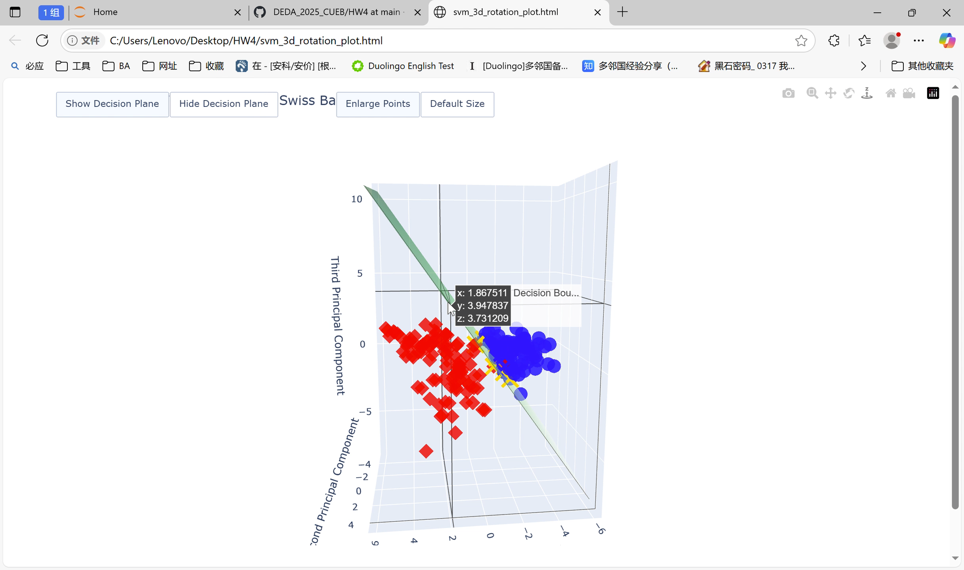
rotation plot for slide 17 in SVM

Slide 4
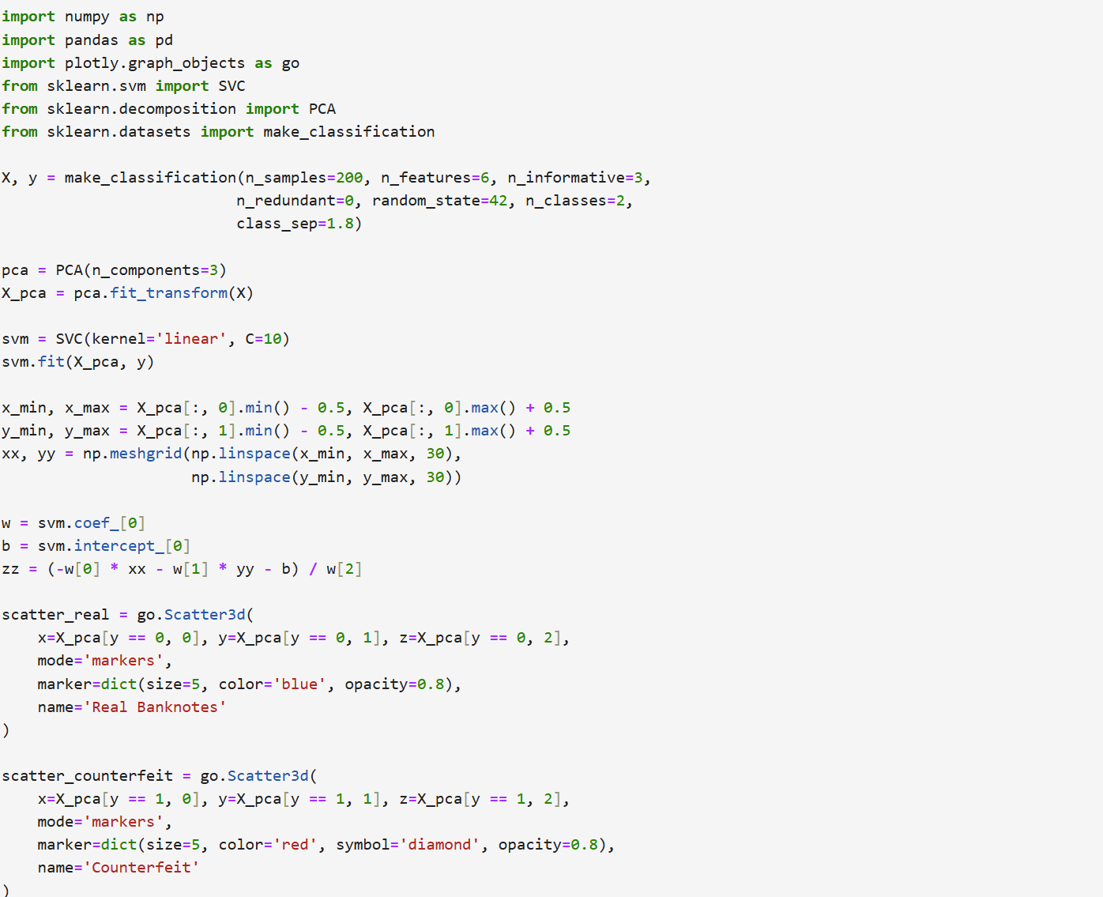
rotation plot for slide 17 in SVM:code

Slide 5
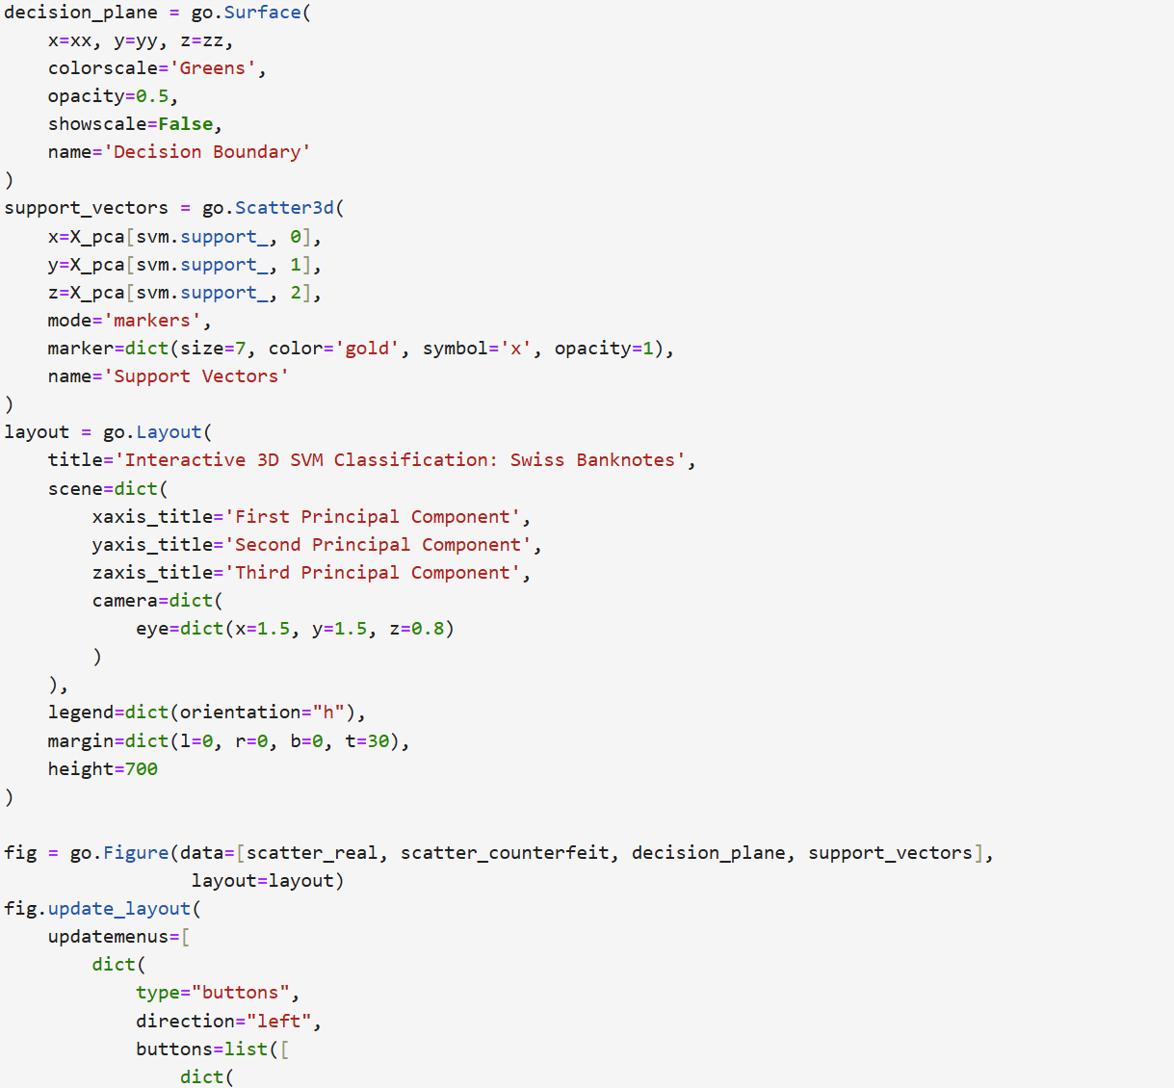
rotation plot for slide 17 in SVM:code

Slide 6
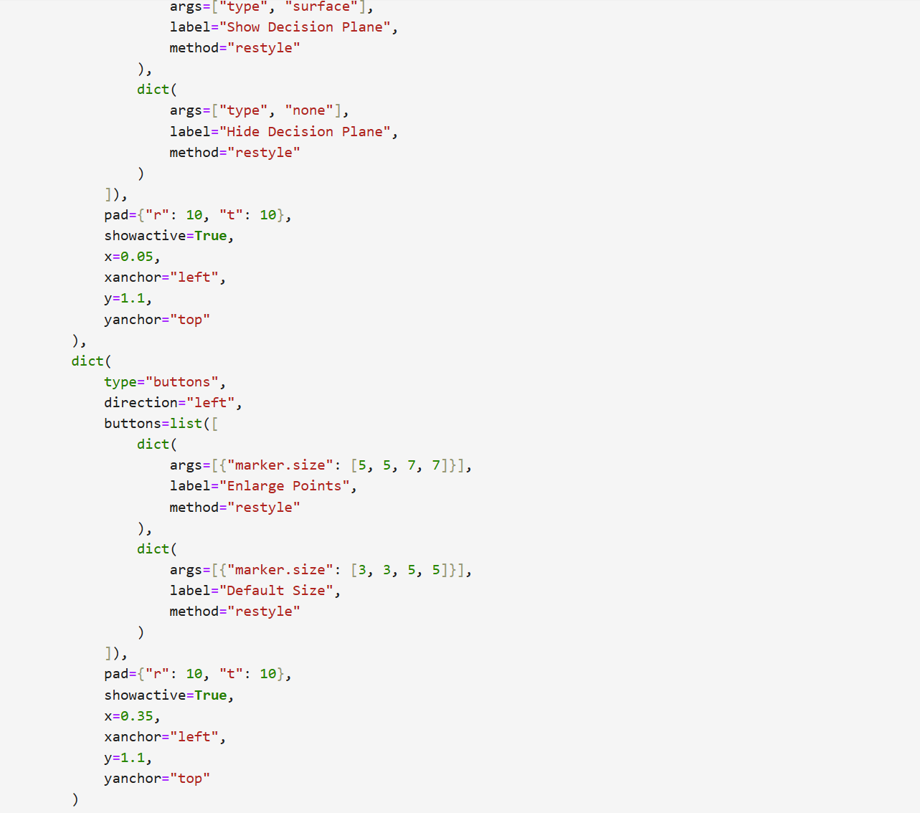
rotation plot for slide 17 in SVM:code

Slide 7
Do SVM on your data of choice
My data choice:UniversalBank.csv,from kaggle
https://www.kaggle.com/datasets/vinod00725/svm-classification

Slide 8
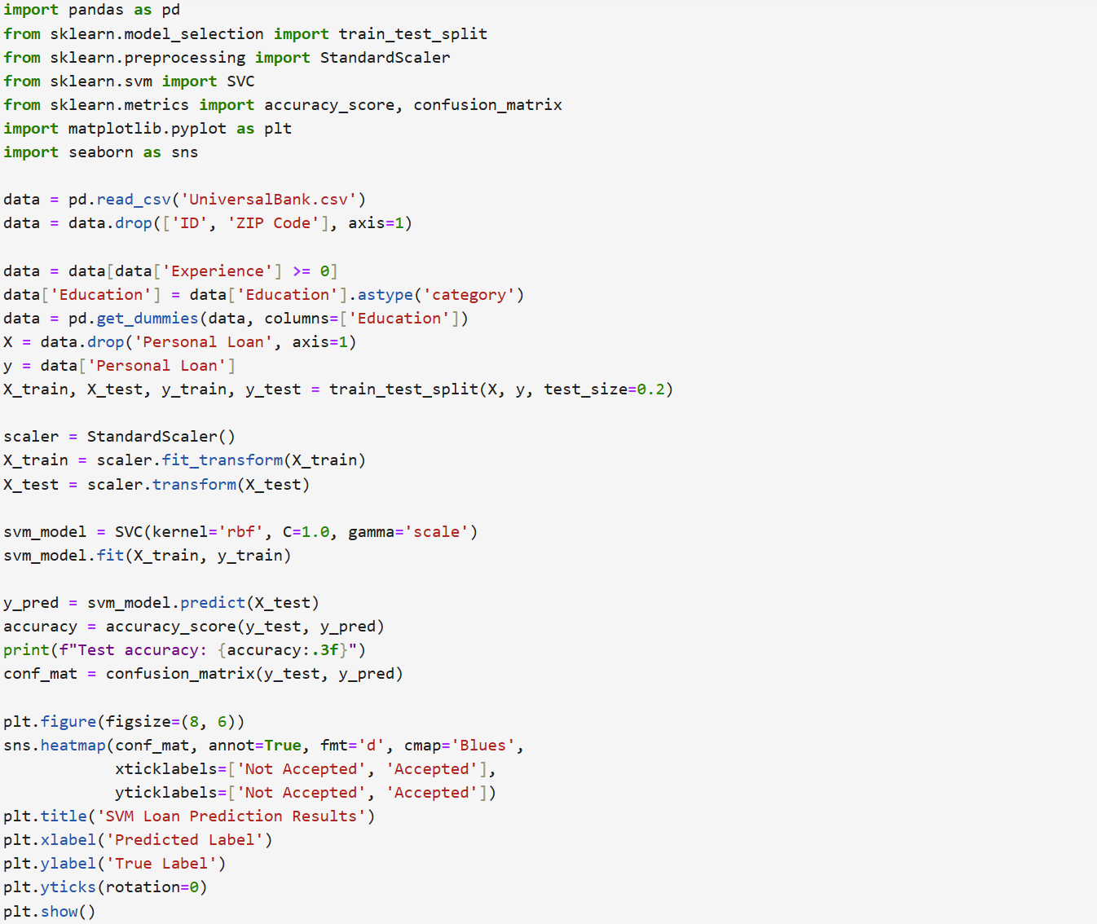
Do SVM on your data of choice:code

Slide 9
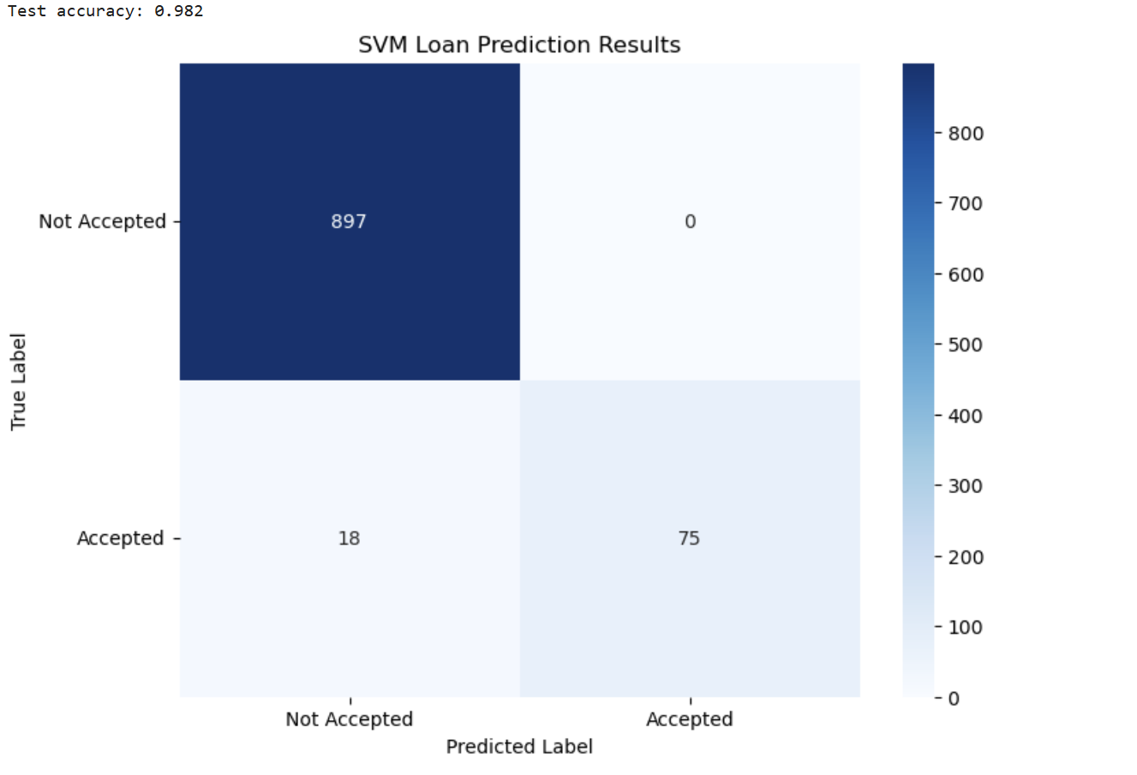
Do SVM on your data of choice

